Slide 1
Bank loan data
GA Final

Slide 2
Background
Q4 2017 Data downloaded from Kaggle, sourced from lending club
Problem – how to predict who will fall behind on loan payments
Hypothesis – those on longer payment terms, and those with lower credit grades would be more likely to fall behind on payments.

Slide 3
process
From 145 columns, reduce to 17 by dropping irrelevant data
Visualise data to see what it looks like

Slide 4
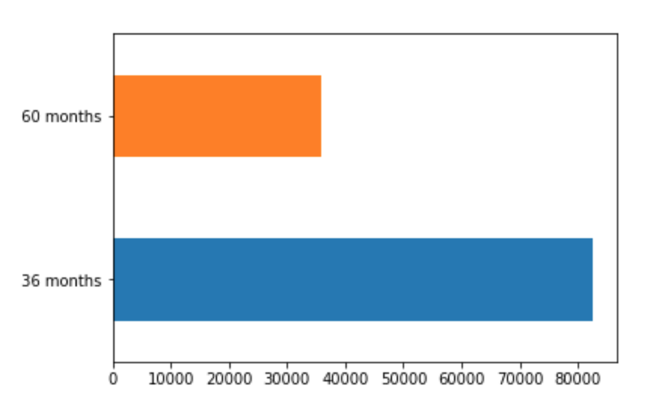
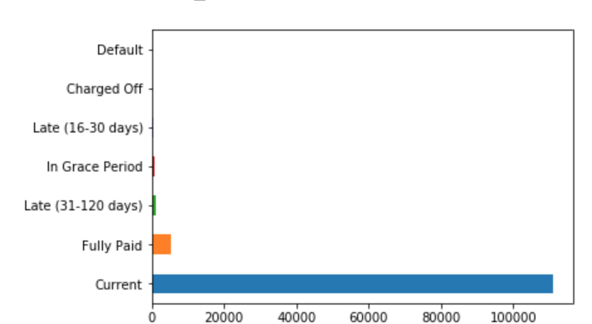
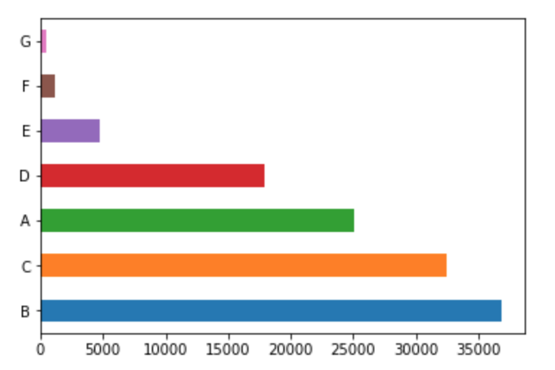
Visualising data
More people are on 3 year terms, vs 5 years
Vast majority of lendees are up to date with payments
B grade lendees are highest in count, G grade the lowest

Slide 5
Grouping and sorting for a clearer view
Grouped loan status into two values, late and not late
Then assessed grouped loan status against lendee grade
As expected, lateness increased with decreasing credit grade, with g the highest at 9.7% of lendees being late. The rate for a grade was 0.07%
Loan term also showed positive correlation between increasing term and increasing risk of being late. 3 years had a lateness rate of 1.8% vs 2.2% for 5 years.

Slide 6
Further action
Look at other parameters, like verification, job, loan amount, postcode, and combinations of these to further refine risk analysis.

